Slide 1
OOPS

Slide 2
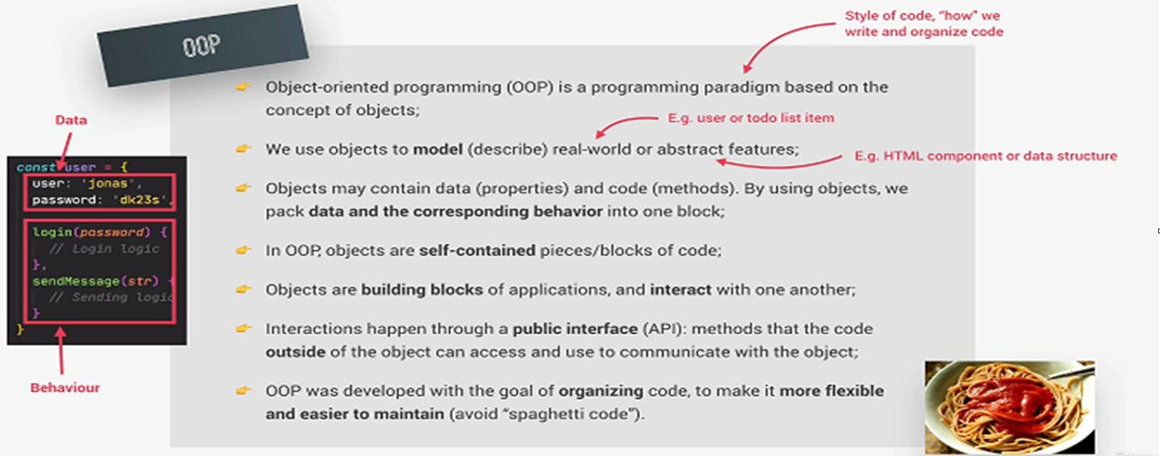
Object Oriented Programming

Slide 3
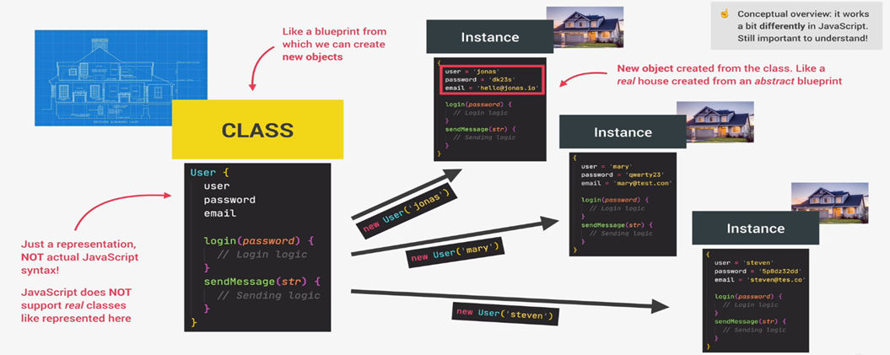
Classes And Instances

Slide 4
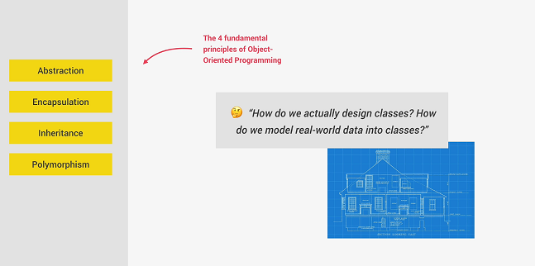
Fundamental of OOPS

Slide 5
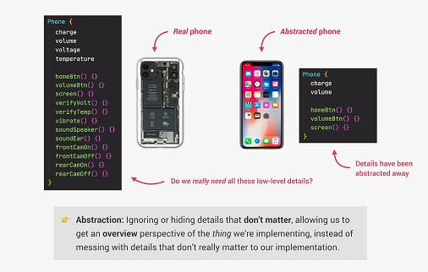
Abstraction

Slide 6
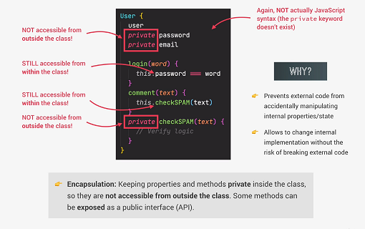
Encapsulation

Slide 7
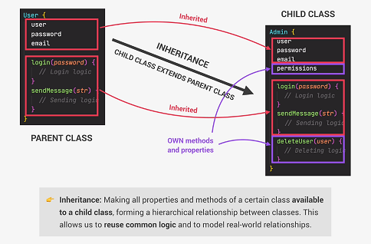
Inheritance

Slide 8
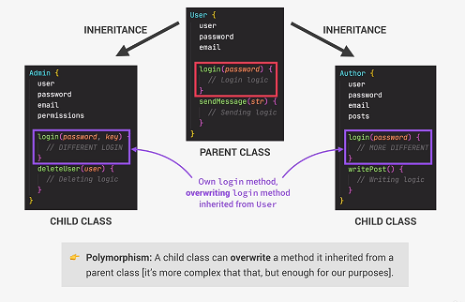
Polymorphism

Slide 9
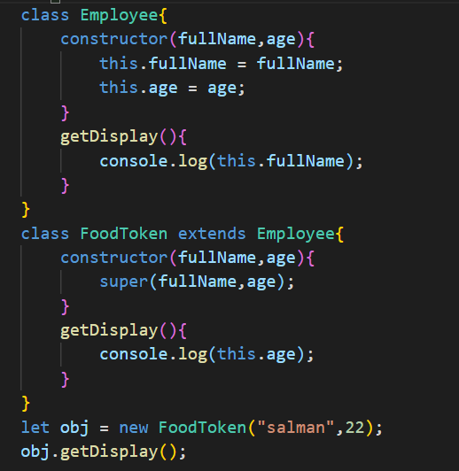
Polymorphism

